Slide 1
Nearest Neighbor Classifier

Slide 2
PENDEKATAN TEORI KEPUTUSAN
Probabilistic Approaches
Bayesian decision
Discriminating Approaches
Neural Network
Support Vector Machine
Rule based Approaches
Fuzzy Inference System
Decision Tree
Association Rule
Instance-based (Distance) Approaches
Nearest Neighbor (k-NN)
Clustering methods

Slide 3
Nearest Neighbor Classifier
Basic idea:
If it walks like a duck, quacks like a duck, then it’s probably a duck
Compute Distance
Test record
Choose k of the “nearest” records
Training records

Slide 4
Nearest-Neighbor Classifier
Requires three things
The set of stored records
Distance Metric to compute distance between records
The value of k, the number of nearest neighbors to retrieve
To classify an unknown record:
Compute distance to other training records
Identify k nearest neighbors
Use class labels of nearest neighbors to determine the class label of unknown record (e.g., by taking majority vote)

Slide 5
Definition of Nearest Neighbor
K-nearest neighbors of a record x are data points that have the k smallest distance to x

Slide 6
Nearest Neighbor Classification
Compute distance between two points:
Euclidean distance
Determine the class from nearest neighbor list
take the majority vote of class labels among the k-nearest neighbors
Weigh the vote according to distance
weight factor, w = 1/d²

Slide 7
k-Nearest Neighbor (k-NN) Algorithm
For every point in dataset:
calculate the distance between X and the current point
sort the distances in increasing order
take k items with lowest distances to X
find the majority class among these items
return the majority class as our prediction for the class of X

Slide 8
How to implement k-NN in Python
Handle Data: Open the dataset from CSV and split into test/train datasets.
Similarity: Calculate the distance between two data instances.
Neighbors: Locate k most similar data instances.
Response: getting the majority voted response from a number of neighbors.
Accuracy: Summarize the accuracy of predictions.
Main: Tie it all together.
https://machinelearningmastery.com/tutorial-to-implement-k-nearest-neighbors-in-python-from-scratch/

Slide 9
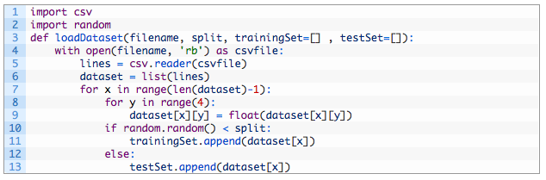
How to implement k-NN in Python
1. Handle Data: Open the dataset from CSV and split into test/train datasets.

Slide 10
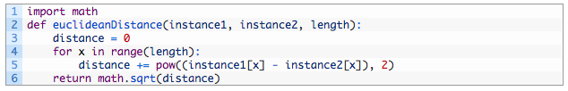
How to implement k-NN in Python
2. Similarity: Calculate the distance between two data instances.

Slide 11
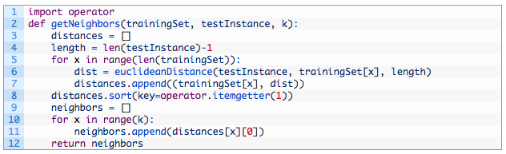
How to implement k-NN in Python
3. Neighbors: Locate k most similar data instances.

Slide 12
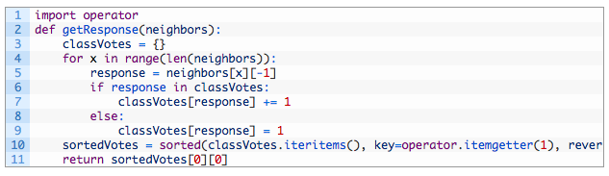
How to implement k-NN in Python
4. Response: a function for getting the majority voted response from a number of neighbors

Slide 13
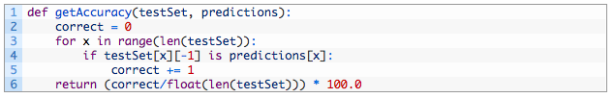
How to implement k-NN in Python
5. Accuracy: Summarize the accuracy of predictions

Slide 14
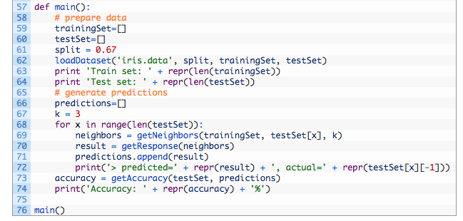
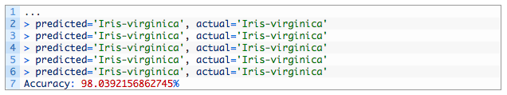
How to implement k-NN in Python

Slide 15
Nearest Neighbor Classification…
Choosing the value of k:
If k is too small, sensitive to noise points
If k is too large, neighborhood may include points from other classes

Slide 16
Nearest Neighbor Classification…
Scaling issues
Attributes may have to be scaled to prevent distance measures from being dominated by one of the attributes
Example:
height of a person may vary from 1.5m to 1.8m
weight of a person may vary from 90lb to 300lb
income of a person may vary from $10K to $1M

Slide 17
Nearest Neighbor Classification…
Problem with Euclidean measure:
High dimensional data
curse of dimensionality
Can produce counter-intuitive results
1 1 1 1 1 1 1 1 1 1 1 0
1 0 0 0 0 0 0 0 0 0 0 0
vs
0 1 1 1 1 1 1 1 1 1 1 1
0 0 0 0 0 0 0 0 0 0 0 1
d = 1.4142
d = 1.4142
Solution: Normalize the vectors to unit length

Slide 18
Other Distance Measures
Hamming Distance: Calculate the distance between binary vectors
Manhattan Distance: Calculate the distance between real vectors using the sum of their absolute difference. Also called City Block Distance
Minkowski Distance: Generalization of Euclidean and Manhattan distance

Slide 19
Nearest neighbor Classification…
k-NN classifiers are lazy learners
It does not build models explicitly
Unlike eager learners such as decision tree induction and rule-based systems
Classifying unknown records are relatively expensive

Slide 20
References
Tan, Steinbach, Kumar, Introduction to Data Mining, 2000
https://machinelearningmastery.com/k-nearest-neighbors-for-machine-learning/

